Slide 1
Exploring Regression Models to Predict General Aviation Aircraft Metrics

Slide 2
Introduction
This study will use popular regression techniques to predict both performance and categorical metrics of popular general aviation aircraft. The aircraft included in this study are widely used across the world for various duties including business, agricultural application, personal travel, airshow performances, and pleasure flying. This study seeks to harness popular regression techniques to accurately predict aircraft metrics such as stall speed, wingspan, horsepower, and number of engines with the end goal of exploring the relationships between aircraft features and performance.

Slide 3
Background
As far as regression analysis in the aviation sector is concerned, the many studies conducted regarding regression analysis tend to focus on predicting commercial aviation flight delay times, flight price, pilot accident rates, and fuel consumption for airliners. All of these topics are directly related to potential cost savings, safety, or gaining a market edge on competitors. The goal of this study has no monetary benefit from the results, the soul purpose being to test relationships between variables that are commonly used to categorize and classify certified general aviation aircraft.

Slide 4
Source and Data Set
The data set used was sourced from Aircraft Bluebook (1). Aircraft Bluebook has specialized in data collection and the production of data visualizations specifically to the aviation sector for over 65 years. The data set used is comprised of information that was sourced and vetted by in house by Aircraft Bluebook, and is published on aircraftbluebook.com for public usage. It is currently on rendition 23-04 and was last updated this year, Fall of 2023. The data set is comprised of 22 total variables and 859 total observations. All the aircraft in the data set are certified general aviation aircraft, this implies that no gliders, military, commercial or experimental aircraft were included.

Slide 5
Libraries Used
library(tidyverse) library(dplyr) library(MASS) library(ggplot2)

Slide 6
The Data
'data.frame': 860 obs. of 25 variables: $ ï..Model : chr "15 AC Sedan" "11 CC Super Chief" "7 CCM Champ" "7 DC Champ" ... $ Company : chr "Aeronca" "Aeronca" "Aeronca" "Aeronca" ... $ Engine.Type : chr "Piston" "Piston" "Piston" "Piston" ... $ Multi.Engine: logi NA NA NA NA NA NA ... $ TP.mods : logi FALSE FALSE FALSE FALSE FALSE FALSE ... $ THR : int NA NA NA NA NA NA NA NA NA NA ... $ SHP : int 145 85 90 85 65 65 700 580 580 580 ... $ Length : num 25.2 20.6 21.4 21.4 21.4 ... $ Height : num 10.25 8.75 8.58 8.58 8.75 ... $ WS : num 37.4 36.1 35 35 35 ... $ FW : num 241.2 100.5 127.3 127.3 93.8 ... $ MEW : int 1180 820 810 800 740 786 4275 4125 4056 3958 ... $ GW : int 2050 1350 1300 1300 1220 1250 6315 6000 6000 6000 ... $ Vmax : num 104 89 90 88 83 78 264 262 257 257 ... $ Vcruise : num 91 83 78 78 74 72 230 247 235 237 ... $ Stall : num 46 44 37 37 33 33 80 77 77 77 ... $ Hmax : int 13000 12300 16000 13000 12500 11000 25000 28000 25000 30000 ... $ Hmax..One. : int NA NA NA NA NA NA 14500 12900 8800 8800 ... $ ROC : int 450 600 650 620 370 360 1820 1755 1460 1460 ... $ ROC..One. : int NA NA NA NA NA NA 320 302 240 240 ... $ Vlo : int 900 720 475 500 632 583 3080 2250 2490 2490 ... $ Slo : int NA NA NA NA NA NA 1950 1800 1900 1900 ... $ Vl : int 1300 800 850 850 885 880 2100 2076 2030 2030 ... $ Sl : int NA NA NA NA NA NA 1425 1217 1230 1230 ... $ Range : int 370 190 210 210 175 180 868 1020 1101 1174 ...

Slide 7
The Variables
The data set is comprised of 22 total variables.
1) Model, the model of the aircraft
2) Company, the production company responsible for producing the aircraft
3) Engine.Type, this describes the type of engine the aircraft uses. ie piston, turboprop, jet
4) Multi.Engine, this contains a factor variable, 1 corresponds to multi-engine, 0 corresponds to single engine
5) TP.mods, if the aircraft contains any airframe or powerplant modifications or conversions done by a third party manufacturer with an STC from the FAA.
6) THR, foot pounds of thrust, this is only applicable to jet engine aircraft. If the aircraft is piston or turboprop powered then this column was left blank
7) SHP, horsepower, this is only applicable to piston or turboprop aircraft. If the aircraft is jet engine powered then this column was left blank
8) Height, measured in feet with inches converted to a decimal
9) Length, measured in feet with inches converted to a decimal
10) WS, wing span, measured in feet with inches converted to a decimal
11) MEW, empty weight, measured in pounds
12) GW, max gross takeoff weight, measured in pounds
13) Vmax, max speed measured in knots
14) Vcruise, cruise speed measured in knots
15) Stall, stall speed with full flaps extended, measured in knots
16) ROC, rate of climb, measured in feet per minute
17) Hmax, operating ceiling, measured in feet
18) Range, aircraft total range, measured in nautical miles
19) Vlo, takeoff distance over a 50ft obstacle, measured in feet
20) Slo, takeoff ground roll, measured in feet
21) Vl, landing distance over a 50ft obstacle, measured in feet
22) Sl, landing ground roll, measured in feet

Slide 8
Observations
The data set is comprised of 859 total observations. Highlighting the first observation we can see…
The aircraft an Aeronca 15 AC Sedan. It is a single engine, non modified, piston powered aircraft producing a total of 145 horsepower. The Aeronca 15 AC Sedan measure 25.25 feet long, 10.25 feet tall, has a wing span of 37.4 feet. It has an empty weight of 1180 pound and a max gross takeoff weight of 2050 pounds. It has a max speed of 104 knots, cruises at 91 knots, and stalls with full flaps at 46 knots. The max operating ceiling for the Aeronca is 13,000 feet, and it gets there with a max rate of climb of 450 feet per minute. With the landing distance over a 50 foot obstacle being 1300 feet, and the takeoff distance over a 50 foot obstacle being 900 feet, it gets in the air rather quickly.
ï..Model Company Engine.Type Multi.Engine TP.mods THR SHP Length Height 1 15 AC Sedan Aeronca Piston NA FALSE NA 145 25.25 10.25 WS FW MEW GW Vmax Vcruise Stall Hmax Hmax..One. ROC ROC..One. 1 37.41667 241.2 1180 2050 104 91 46 13000 NA 450 NA Vlo Slo Vl Sl Range 1 900 NA 1300 NA 370

Slide 9
Cleaning
Most of the cleaning regarding the data set was done in excel, with the post exploratory analysis cleaning, splitting, and transforming done in R. The first task for cleaning regarded the SHP (horsepower) and THR (thrust) variables. The data set recorded thrust and horsepower per engine, not the total. For the analysis conducted, it was essential that total horsepower for the aircraft was recorded. This was remedied by multiplying the previous recorded horsepower per engine, by the total number of engine on the aircraft. Giving us a total horsepower figure suitable for analysis. This same process was then repeated for the thrust measurements in regards to jet engine aircraft.

Slide 10
Data Transformations
Also for analysis purposes, the Multi.Engine variable was converted into a factor in order to run a logistic regression. Before being converted to a factor, if the aircraft featured multiple engines then a TRUE logical value was recorded. If the aircraft did not feature multiple engines then an NA logical value was recorded. When converting into a factor, 1 was assigned to multi engine aircraft and 0 was assigned to single engine aircraft. During analysis boxcox transformations were completed and the transformed variable values were stored under names denoted boxcox in there respected data set.

Slide 11
Methodology
For analysis purposes, a sub data set of the original data set was created containing only propeller driven aircraft. So this second data set was comprised of both piston and turboprop powered aircraft but not jet engine powered. This was done because after exploratory analysis was started in order to combat some discrepancies in the data. Because the design characteristics are so vastly different for general aviation propeller and jet aircraft, for an accurate predictive analysis it was essential to create a second data set containing only one propulsion type. A train and test set was then created for both the original data set and the propeller data set. The train and test sets used a standard 70:30 split with 70% of the data be allotted to the training set. This was done to test model accuracy and minimize the risk of over fitting.

Slide 12
Data Transformations and Methodology
airnew <- airnew1 %>% filter(!row_number() %in% c(529)) airnew$Multi.Engine <- ifelse(is.na(airnew$Multi.Engine), 0, ifelse(airnew$Multi.Engine, 1, NA)) ### Creating separate data set for propelleraircraft airprop <- airnew[!(airnew$Engine.Type == "Jet"),] ### Test and Train Data Split for both data sets set.seed(123) airnewtrain<- sample(nrow(airnew), 0.70*nrow(airnew), replace=FALSE) airnewTrain <- airnew[airnewtrain,] airnewTest <- airnew[-airnewtrain,] airproptrain<- sample(nrow(airprop), 0.70*nrow(airprop), replace=FALSE) airnewTrainProp <- airprop[airproptrain,] airnewTestProp <- airprop[-airproptrain,]

Slide 13
Types of Models
This study is consists of two different types of regression models. Two different iterations of a single linear regression model, a second linear regression model with two iterations, a third linear regression model, and finally a logistic regression model. These models were selected both on the inherent makeup of the data, as well as linear relationships that were found in exploratory analysis through graphing.

Slide 14
Model 1 Using Linear Regression to Predict Stall Speed
The first model created utilized the data set containing only propeller driven aircraft. It used stall speed as the predicted variable with horsepower, wing span, max speed, and length as explanatory values, all of which are statistically significant with P values less than 0.5. The first iteration of the model can be seen below. For both model iterations the intercept was forced through zero, and both models were trained using the training data set developed for propeller aircraft and tested on the testing data set developed for propeller driven aircraft.

Slide 15
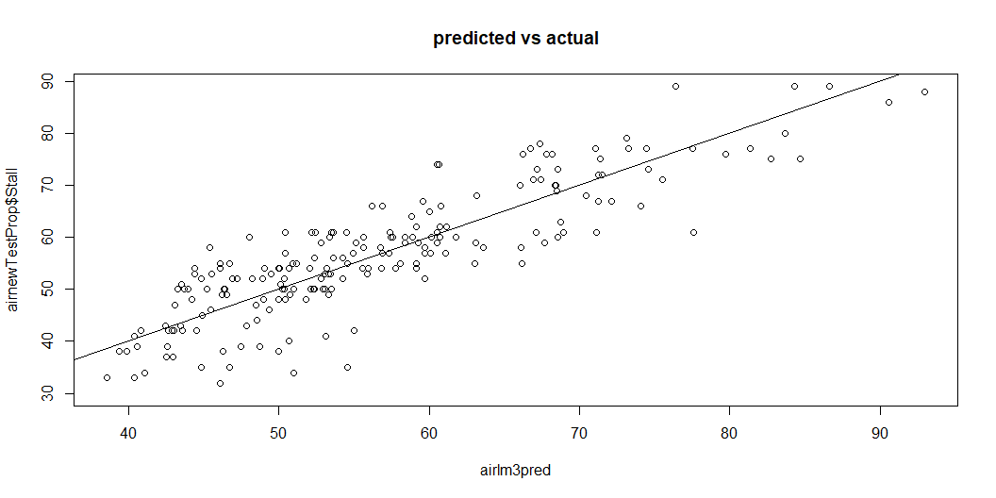
Model 1, Iteration 1
Call: lm(formula = Stall ~ SHP + WS + Vmax + Length - 1, data = airnewTrainProp) Residuals: Min 1Q Median 3Q Max -22.5894 -3.4152 0.5753 4.2608 17.4712 Coefficients: Estimate Std. Error t value Pr(>|t|) SHP -0.005136 0.001077 -4.770 2.47e-06 *** WS 0.278373 0.070044 3.974 8.18e-05 *** Vmax 0.133244 0.008001 16.654 < 2e-16 *** Length 0.848866 0.112985 7.513 2.97e-13 *** --- Signif. codes: 0 '***' 0.001 '**' 0.01 '*' 0.05 '.' 0.1 ' ' 1 Residual standard error: 6.284 on 467 degrees of freedom (21 observations deleted due to missingness) Multiple R-squared: 0.9886, Adjusted R-squared: 0.9885 F-statistic: 1.009e+04 on 4 and 467 DF, p-value: < 2.2e-16

Slide 16
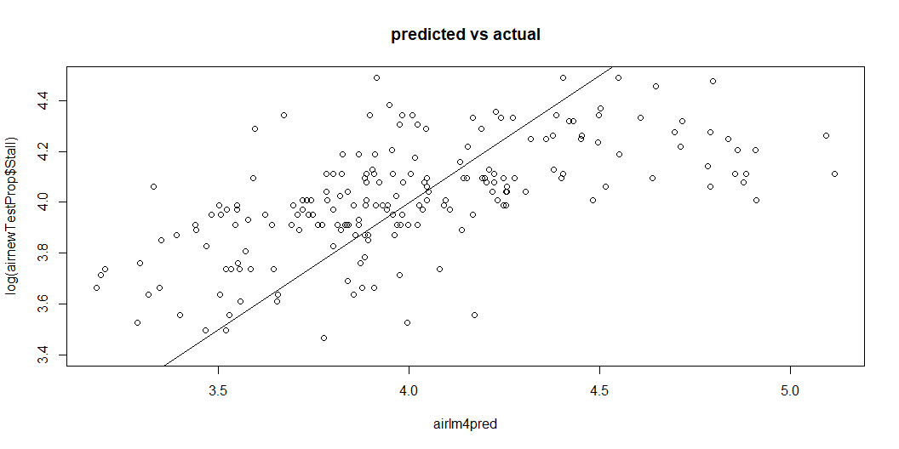
Model 1, Iteration 2
Call: lm(formula = log(Stall) ~ SHP + WS + Vmax + Length - 1, data = airnewTrainProp) Residuals: Min 1Q Median 3Q Max -1.43047 -0.12018 0.04643 0.21592 1.04300 Coefficients: Estimate Std. Error t value Pr(>|t|) SHP -1.557e-03 6.104e-05 -25.506 < 2e-16 *** WS 5.583e-02 3.971e-03 14.059 < 2e-16 *** Vmax 6.152e-03 4.535e-04 13.565 < 2e-16 *** Length 5.087e-02 6.405e-03 7.942 1.5e-14 *** --- Signif. codes: 0 '***' 0.001 '**' 0.01 '*' 0.05 '.' 0.1 ' ' 1 Residual standard error: 0.3562 on 467 degrees of freedom (21 observations deleted due to missingness) Multiple R-squared: 0.9922, Adjusted R-squared: 0.9922 F-statistic: 1.495e+04 on 4 and 467 DF, p-value: < 2.2e-16

Slide 17
Model 1 Results
As seen from the summary results. the second iteration of model one containing the log transformation of Stall Speed resulted in a higher adjusted R squared, .99 as compared to .98, as well as a lower residual standard error, .35 as compared to 6.28. When examining the predicted vs actual plots for both model iterations, the first iteration containing no transformation to stall speed results in a more linear fit that is condensed closer to the plotted 45 degree abline. The residual vs fit, and normal qq plots can be seen in the appendix of the paper.

Slide 18
Model 2 Using Linear Regression to Predict Horsepower
The second model created utilized the data set containing only propeller driven aircraft. It used horsepower as the predicted variable with length, and max gross takeoff weight as explanatory values, both of which are statistically significant with P values less than 0.5. The first iteration of the model can be seen below. For both model iterations the intercept was forced through zero, and both models were trained using the training data set developed for propeller aircraft and tested on the testing data set developed for propeller driven aircraft.

Slide 19
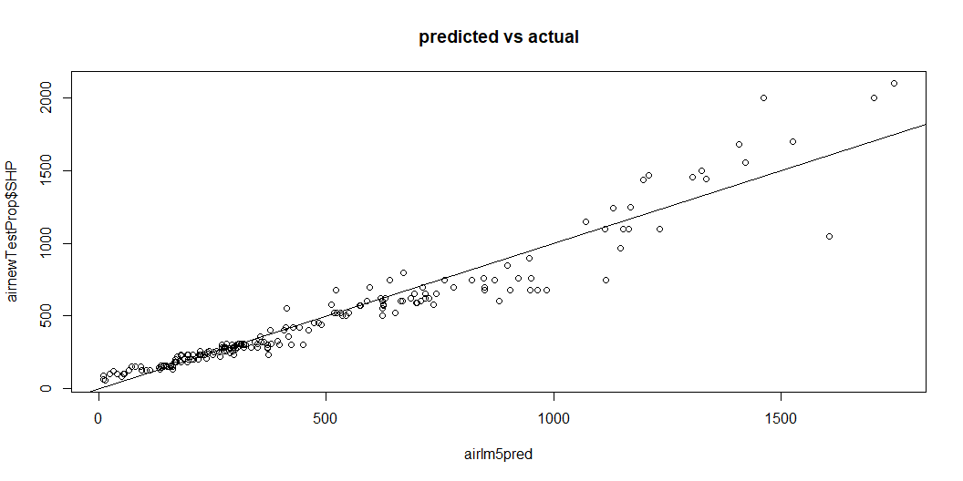
Model 2, Iteration 1
Call: lm(formula = SHP ~ Length + GW - 1, data = airnewTrainProp) Residuals: Min 1Q Median 3Q Max -554.30 -34.68 -4.15 27.50 870.02 Coefficients: Estimate Std. Error t value Pr(>|t|) Length -7.670519 0.476956 -16.08 <2e-16 *** GW 0.148901 0.002588 57.53 <2e-16 *** --- Signif. codes: 0 '***' 0.001 '**' 0.01 '*' 0.05 '.' 0.1 ' ' 1 Residual standard error: 113.8 on 487 degrees of freedom (3 observations deleted due to missingness) Multiple R-squared: 0.9662, Adjusted R-squared: 0.966 F-statistic: 6952 on 2 and 487 DF, p-value: < 2.2e-16

Slide 20
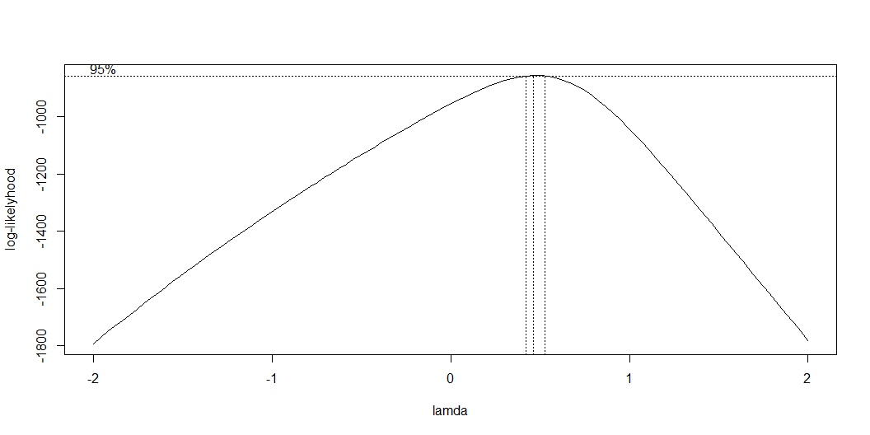
Model 2, Iteration 2

Slide 21
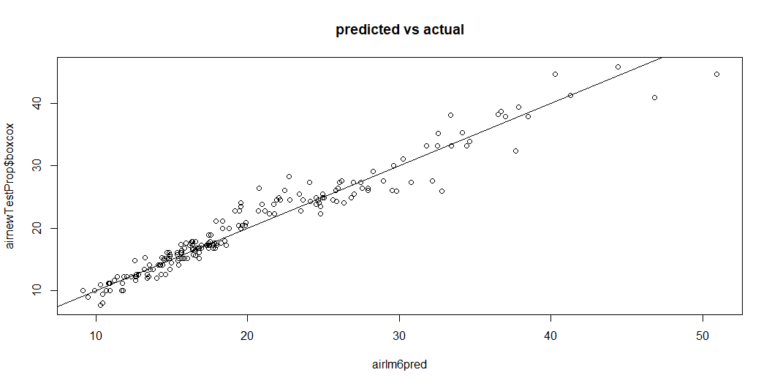
Call: lm(formula = boxcox ~ Length + GW - 1, data = airnewTrainProp) Residuals: Min 1Q Median 3Q Max -8.9284 -0.8004 -0.0035 1.0393 12.9501 Coefficients: Estimate Std. Error t value Pr(>|t|) Length 3.539e-01 8.436e-03 41.95 <2e-16 *** GW 2.066e-03 4.578e-05 45.13 <2e-16 *** --- Signif. codes: 0 '***' 0.001 '**' 0.01 '*' 0.05 '.' 0.1 ' ' 1 Residual standard error: 2.012 on 487 degrees of freedom (3 observations deleted due to missingness) Multiple R-squared: 0.9913, Adjusted R-squared: 0.9912 F-statistic: 2.759e+04 on 2 and 487 DF, p-value: < 2.2e-16

Slide 22
Model 2 Results
As seen from the summary results, The second iteration of model 2 containing the boxcox transformation of the square root of horsepower resulted in a higher adjusted R squared, .99 as compared to .96, as well as a lower residual standard error, 2.01 as compared to 113.8. The predicted vs actual plots also convey that the second iteration was a better fit, although the predicted values for both plots fit the 45 degree abline closely. That being said, the values towards the middle are of a more linear nature in the plot for the second iteration than that of first. The residual vs fit, and normal qq plots can be seen in the appendix of the paper.

Slide 23
Model 3 Using Linear Regression to Predict Wing Span
The third model created utilized the data set containing only propeller driven aircraft. It used wing span as the predicted variable with length, and max gross takeoff weight as explanatory values, both of which are statistically significant with P values less than 0.5. For the model the intercept was forced through zero, the model was trained using the training data set developed for propeller aircraft and tested on the testing data set developed for propeller driven aircraft.

Slide 24
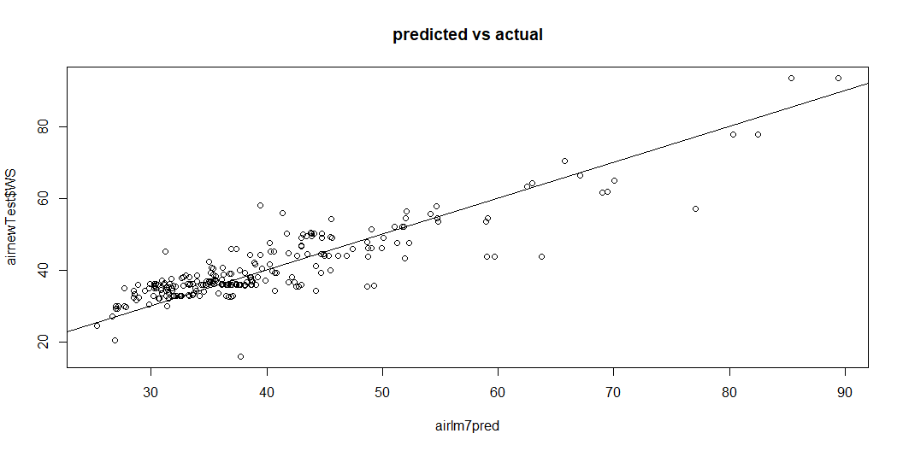
Model 3
Call: lm(formula = WS ~ GW + Length + Vmax - 1, data = airnewTrain) Residuals: Min 1Q Median 3Q Max -32.267 -1.507 1.007 4.106 22.974 Coefficients: Estimate Std. Error t value Pr(>|t|) GW -5.020e-04 1.965e-05 -25.55 <2e-16 *** Length 1.633e+00 2.715e-02 60.14 <2e-16 *** Vmax -4.479e-02 3.534e-03 -12.67 <2e-16 *** --- Signif. codes: 0 '***' 0.001 '**' 0.01 '*' 0.05 '.' 0.1 ' ' 1 Residual standard error: 5.581 on 562 degrees of freedom (36 observations deleted due to missingness) Multiple R-squared: 0.9835, Adjusted R-squared: 0.9834 F-statistic: 1.114e+04 on 3 and 562 DF, p-value: < 2.2e-16

Slide 25
Model 3 Results
As seen from the summary results, model 3 contained an adjusted R squared of .98 and a residual standard error of 5.581. Both explanatory variables contained significant P values. The predicted vs actual plot resembles a linear structure that closely follows the plotted abline. As wing span increases, more variance in the predicted values can be seen. The residual vs fit, and normal qq plots can be seen in the appendix of the paper.

Slide 26
Model 4 Using Logistic Regression to Predict and Classify Number of Engines
The fourth model created utilized the data set containing only propeller driven aircraft. It used Multi.Engine as the binary predicted variable with length, and max gross takeoff weight as explanatory values, both of which are statistically significant with P values less than 0.5. The model used the logit link function, and the model was trained using the training data set developed for propeller aircraft and tested on the testing data set developed for propeller driven aircraft.

Slide 27
Model 4
Call: glm(formula = Multi.Engine ~ GW + Length, family = binomial(link = "logit"), data = airnewTrainProp) Deviance Residuals: Min 1Q Median 3Q Max -3.8565 -0.4501 -0.2357 0.2360 2.4366 Coefficients: Estimate Std. Error z value Pr(>|z|) (Intercept) -1.063e+01 1.628e+00 -6.525 6.79e-11 *** GW 6.623e-04 1.500e-04 4.416 1.00e-05 *** Length 2.432e-01 7.168e-02 3.393 0.000691 *** --- Signif. codes: 0 '***' 0.001 '**' 0.01 '*' 0.05 '.' 0.1 ' ' 1 (Dispersion parameter for binomial family taken to be 1) Null deviance: 640.14 on 488 degrees of freedom Residual deviance: 290.53 on 486 degrees of freedom (3 observations deleted due to missingness) AIC: 296.53 Number of Fisher Scoring iterations: 6
GW Length 1.000663 1.275332
[1] 6.044299e-77
[1] 0.5461522
FALSE TRUE 0.1753555 0.8246445

Slide 28
Model 4 Results
As seen in the results summary, the logistic model contained a AIC of 296, will a null deviance of 640 and residual deviance of 290. The logistic model used the logit link function as it produced a more accurate model in exploratory testing when compared to the probit link function. The coefficient estimates where 1.000663 for max gross takeoff weight and 1.275332 for length. This implies that for a one unit increase in max gross takeoff weight, the log odds of the aircraft being a twin engine increases 1.000663. For a one unit increase in length, the log odds of the aircraft being a twin engine increases 1.275332. The chi sq lack of fit for the model was 6.044299e-77 indicating that the model is a good fit. The model had a McFadden Pseudo R squared of .546. Finally, when testing the logistic model using the test set, we can see it accurately classified an aircraft as multi engine or single engine 82.4% of the time.

Slide 29
Method of Model Iteration Selection
The iteration chosen for each model was based on a combination of factors in regards to each individual model. The main methods for the linear regression model selections were the adjusted R squared value, residual sum of squares, and an examination of the predicted vs actual graph. When choosing which link function to use for the logistic model, AIC, null deviance, residual deviance, and accuracy percentage of predictions on the test set were all taken into account.

Slide 30
Model 1 Conclusions
The first iteration of model 1 contained an adjusted R squared value of .98. Leading to the conclusion that 98% of the variance in stall speed can be attributed to horsepower, wing span, max speed, and length. The coefficient estimates signify the change in the mean of stall speed for a one unit increase in the selected explanatory variable. For a one unit increase in horsepower, a decrease of .005 knots can be expected in stall speed. For a one unit increase in wing span, an increase of .278 knots can be expected in stall speed. For a one unit increase in max speed, an increase of .133 knots can be expected in stall speed. For a one unit increase in length, an increase of .848 knots can be expected in stall speed.

Slide 31
Model 2 Conclusions
The second iteration of model 2 featuring the square root transformation of the horsepower variable contained an adjusted R squared value of .99. Suggesting that 99% of the variance in horsepower can be attributed to only length and max gross takeoff weight. For a one unit increase in length, an increase of .35 can be seen in the square root of horsepower. For a one unit increase in max gross takeoff weight, an increase of .00266 can be seen in the square root of horsepower.

Slide 32
Model 3 Conclusions
Model 3 contained an adjusted R squared of .98. Suggesting that 98% of the variance in wing span can be attributed to length, max gross takeoff weight, and max speed. For a one unit increase in length, an increase of 1.633 feet can be seen in wing span. For a one unit increase in max gross takeoff weight, a decrease of .0005 feet can be seen in wing span. For a one unit increase in max speed, a decrease of .0479 feet can be seen in wing span.

Slide 33
Model 4 Conclusions
The logistic regression model featured a McFadden’s Psuedo R squared value of .546. Suggesting that 54.6% of the variance in whether or not an aircraft featured multiple engines could be attributed to max gross takeoff weight and length. The coefficient estimates for a logistic regression signify log odds. For a one unit increase in max gross takeoff weight, the log odds of the aircraft being multi engine increase 1.000663. For a one unit increase in length, the log odds of the aircraft being multi engine increase 1.275332. The logistic regression model also featured an accuracy rate of 82.4% when tested on the test set of data, this leads to the conclusion that the model correctly classifies an aircraft a little of 4/5 of the time.

Slide 34
Future Work

Slide 35
References
(1) “Performance & Specifications.” Aircraftbluebook.com,
aircraftbluebook.com/Tools/ABB/ShowSpecifications.do.

